Slide 1

The principals of Next generation and Third Generation Sequencing
Dr Adam Cribbs

Slide 2
Sequencing technologies
Next Generation Sequencing
Refers to methods developed after Sanger sequencing that offer greatly increase throughput at reduced cost per base.
Third Generation Sequencing
Methods newer than NGS are referred to as third generation.

Slide 3
Sequencing technologies

Slide 4
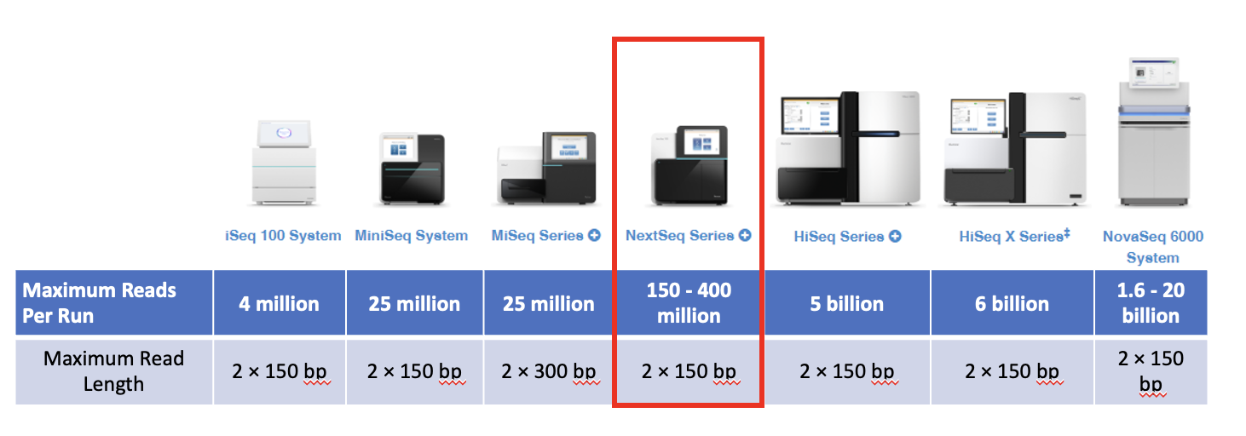
Illumina sequencing
The Illumina family of sequencers all use sequencing by synthesis (SBS) technology

Slide 5
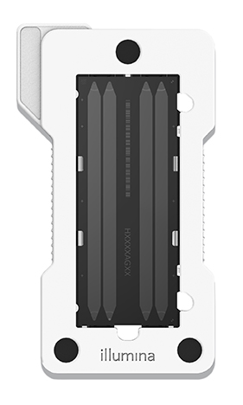
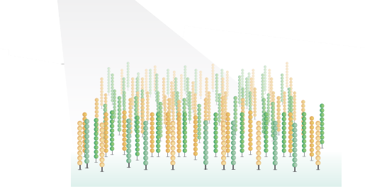
Sequencing by synthesis

Slide 6


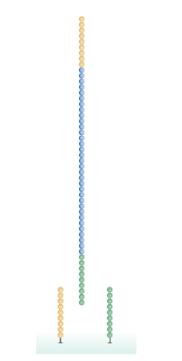
Sequencing by synthesis
DNA
or
RNA
Library production
Denaturation
Index 2
Adaptors
Index 1
P5
P7
Sequence of interest
Hybridisation to flowcell

Slide 7
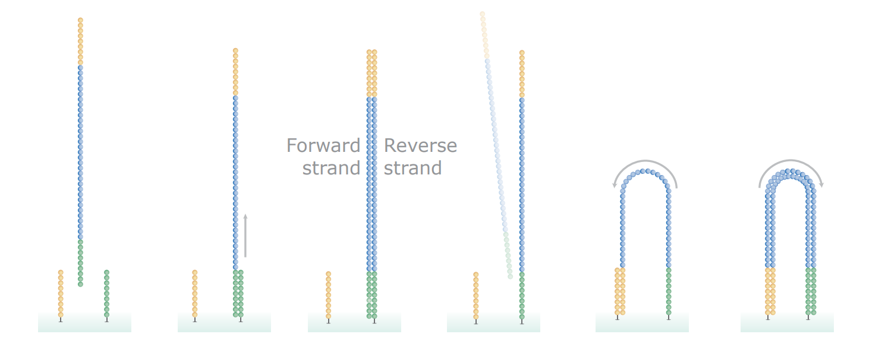
Sequencing by synthesis
Only reverse strand is anchored
Forward
strand
Reverse
strand
Hybridisation to flowcell
Reverse
strand
synthesis
Remove forward strand
Reverse strand can hybridise to second primer
Synthesise second strand

Slide 8
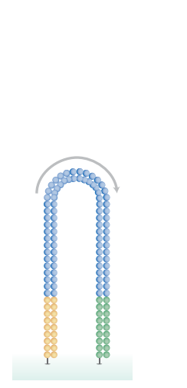
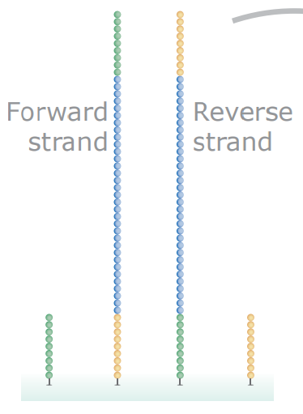
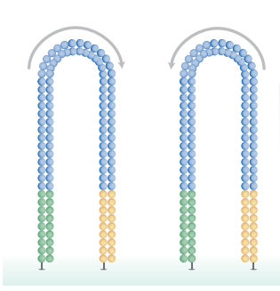
Sequencing by synthesis
Forward
strand
Reverse
strand
Bridge
Amplification
Denature

Slide 9
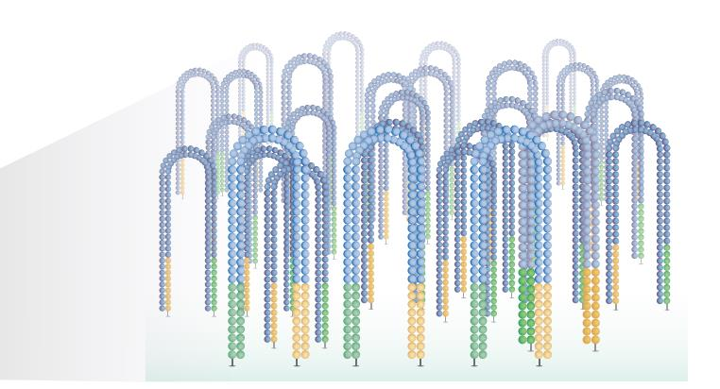
Sequencing by synthesis
Thousands of molecules are amplified to form clusters with the same sequence

Slide 10
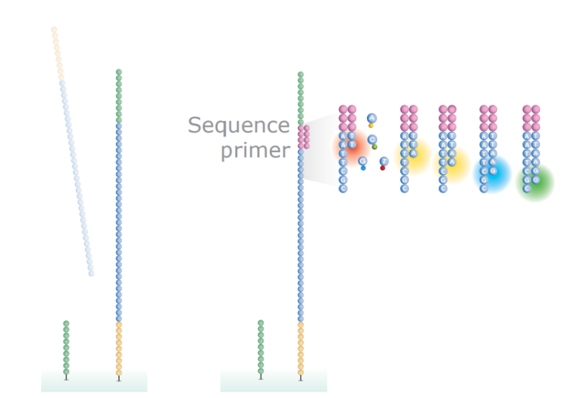
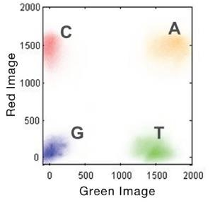
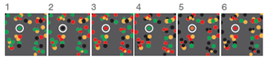
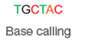
Sequencing by synthesis
1
2
3
4
5
6
Sequence
primer
NextSeq chemistry uses only two
dyes. C is red, T is green, A is both
(yellow) and G has no dye (no
fluorescent signal)
Before the next chemistry cycle proceeds, the blocked 3’ end and the fluorophore from each incorporated base is removed, to allow incorporation of the next base
The reverse strand is cleaved (USER) and washed away, p5 ends are blocked
With each cycle, fluorescently tagged nucleotides are incorporated into the growing chains and clusters are imaged

Slide 11
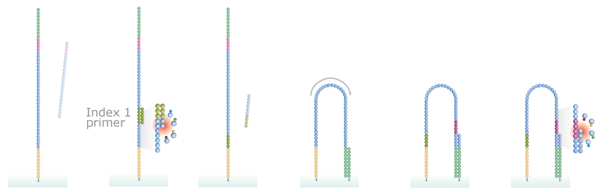
Sequencing by synthesis
Index 1
primer
The read product is washed
away
Index 1 is sequenced
The read product is washed
away
Hybridise
to P5 oligo
Deblock P5
oligo and add
unlabelled bases
Index 2 is sequenced

Slide 12
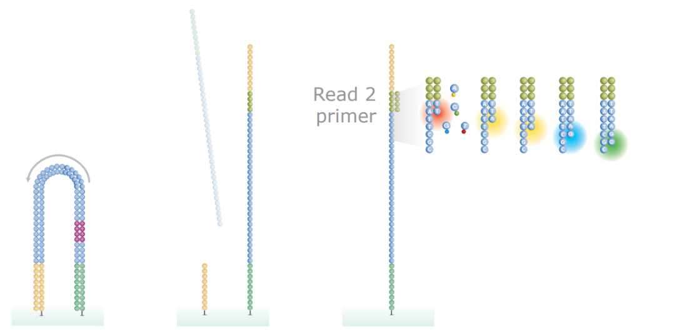
Sequencing by synthesis
Read 2
primer
Synthesise second
strand
The forward strand is cleaved (Fpg) and washed away
The second
read is
sequenced

Slide 13
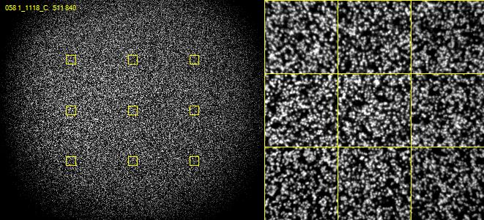
Raw Sequencing Data

Slide 14
Library production
Library production will vary depending on what sequencing-based methodology is being performed:
RNA-seq
ATAC-seq
ChIP-seq
scRNA-seq
CUT&TAG-seq

Slide 15
Library production: RNA-seq
RNAseq quantitatively interrogates the all the RNA transcripts of a population of cells at a given point in time (transcriptomics)
In practice, it is difficult (and more costly) to examine all types of RNA simultaneously, so target RNA is specifically isolated
Also, ~85% of cellular RNA is ribosomal and is usually not of interest
PolyA selection: Selects almost all protein coding mRNA and some lncRNA
Ribosomal depletion: Selects all mRNA and lncRNA, but is considerably more expensive than polyA selection
Small non-coding RNA selection: Selects miRNAs, piRNAs, snoRNAs, snRNAs etc. Method of total RNA extraction is important.

Slide 16
Library production: RNA-seq
A wide range of commercial RNAseq library prep kits are available, most of which use fairly similar principles
Illumina produce the TruSeq Stranded mRNA kit
At the Botnar, we use the more economical NEBNext Ultra II Directional RNA Library Prep Kit for Illumina
Both of these are stranded or directional protocols, meaning you can tell which strand the mRNA came from
Some regions of the genome produce overlapping transcripts from opposite strands (one is usually a non-coding antisense regulatory RNA)
Unstranded library prep could not distinguish between these two transcripts

Slide 17
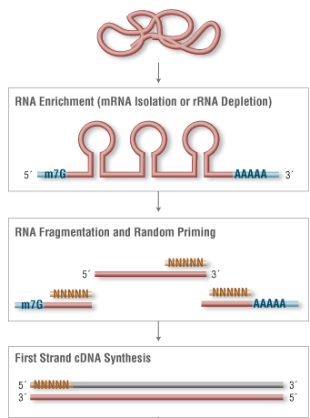
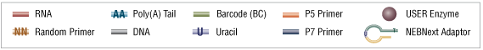
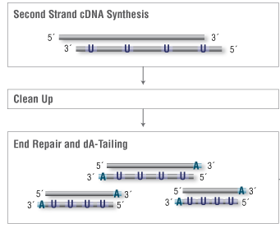
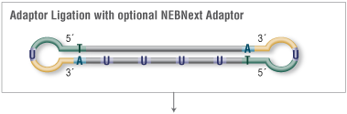
Library production: RNA-seq
polyT labelled magnetic beads
or
rRNA probes followed by RNAse H digest or bead capture
DNA polymerase I
AMPure XP paramagnetic beads
Mixture of mesophilic DNA polymerase
and thermophilic Taq polymerase?
94°C for ~15 minutes
Reverse transcriptase
T4 DNA Ligase

Slide 18
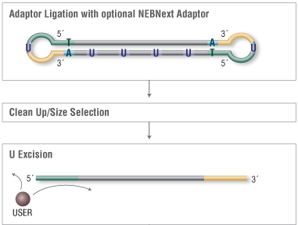
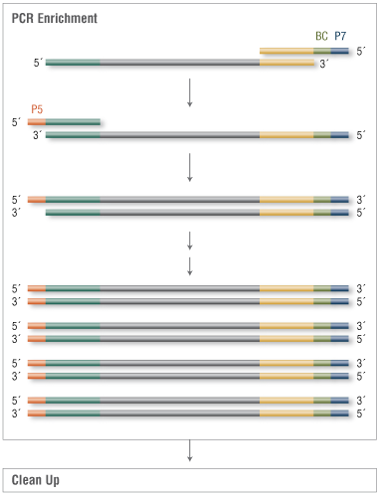
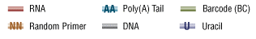
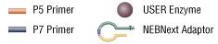
Library production: RNA-seq
PCR primers add P5, P7 and index sequences
T4 DNA Ligase
AMPure XP paramagnetic beads
USER enzyme is a mixture of E. coli uracil DNA glycosylase and endonuclease VIII. Together, these enzymes excise uracils, creating single stranded DNA breaks

Slide 19
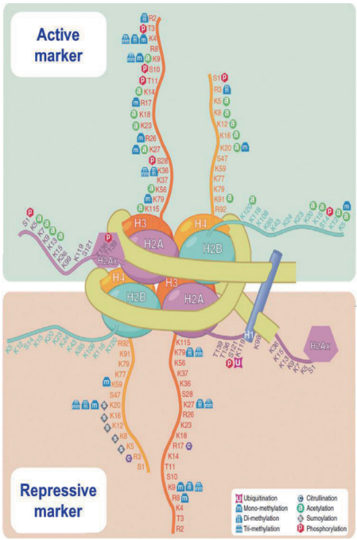
Library production: ChIP-seq
ChIPseq allows the mapping of specific proteins or post-translationally modified proteins (particularly histones) to DNA
Open Chromatin

Activation
Histone tails can be modified
Methylation
Acetyation
Phosphorylation
Leads to changes in chromatin conformation
This process is regulated by a number of enzymes
Methyltransferases
Demethylases
Acetylases
Deacetylases
Transcription factors
Chromatin modifiers
Condensed Chromatin

Repression

Slide 20
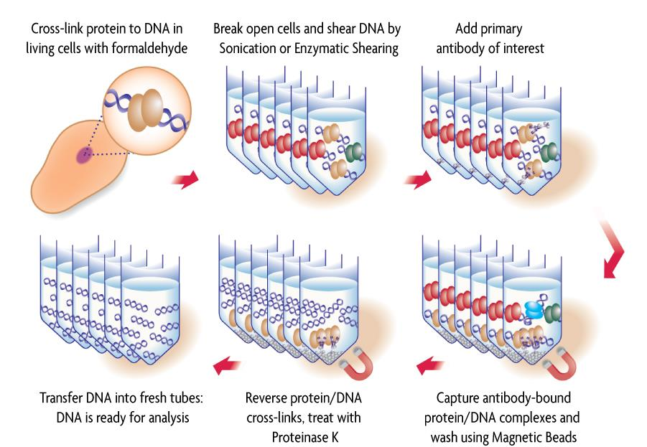
Library production: ChIP-seq
https://www.activemotif.com/catalog/507/chip-it-express-high-throughput

Slide 21
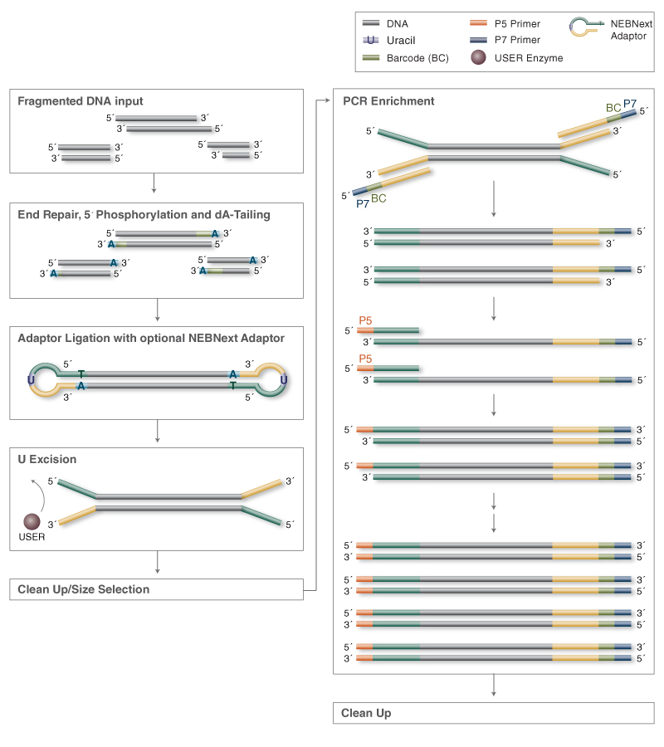
Library production: DNA (ChIP-seq, WGS e.c.t.)
Protocol the same as RNA library prep from end repair step onwards
Does not need to be stranded (both strands will map to the same location)

Slide 22
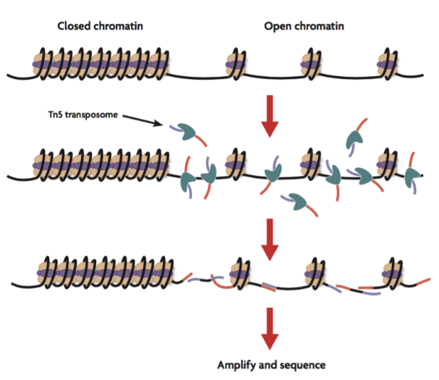
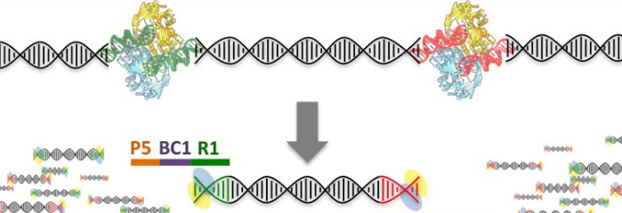
Library production: ATAC-seq
ATACseq (Assay for Transposase-Accessible Chromatin using sequencing) is a technique used to study chromatin accessibility
It is particularly useful for identifying regulatory regions, e.g. promoters, enhancers, insulators
It is based on the concept that open chromatin (ie active) is more accessible to attack by Tn5 Transposase
Transposase is loaded with Mosaic End Double-Stranded (MEDS) oligos
Transposase cleaves DNA, append the MEDS to the cut ends and remains bound to DNA

Slide 23
Library production: ATAC-seq
Extract nuclei from cells/tissue of interest
Maintains chomatin structure while allowing Tn5 access to chromatin
Genomic DNA for whole genome sequencing
Incubate with Tn5 for 30 minutes @ 37°C
Tn5 ratio to DNA is critical
Typically ~65,000 cells / 2.5 ul Tn5
This is how Illumina Nextera kits work
PCR with primers recognising MEDS that add P5, P7 and indexes
Clean up
AMPure XP beads
Sequence

Slide 24
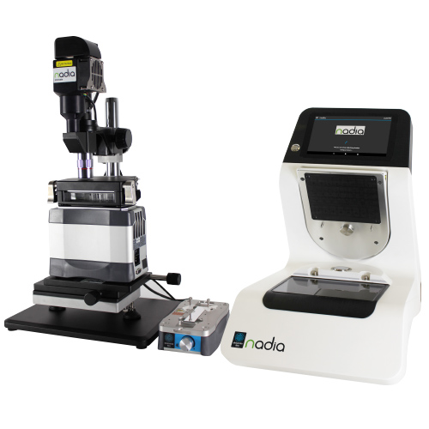
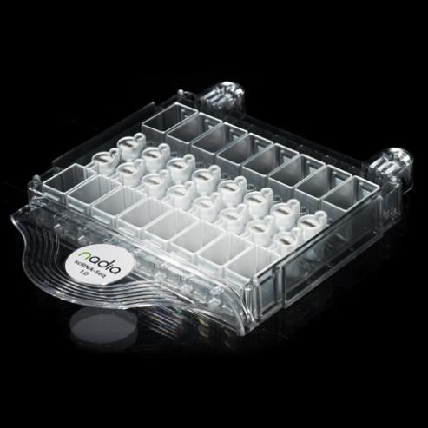
Library production: single-cell
Dolomite Bio Nadia Innovate
Commercialised version of original Drop-Seq system (Cell. 2015 May 21;161(5):1202-1214.)
System is a microdroplet encapsulator
Allows custom assay development
Can run 1, 2, 4 or 8 lanes in parallel

Slide 25
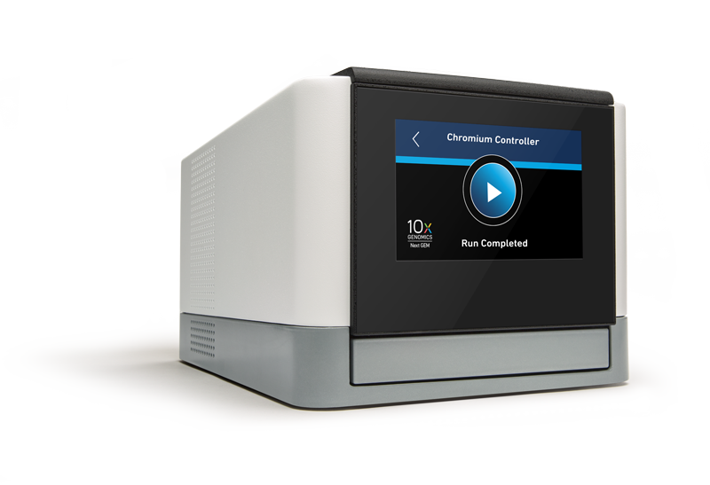
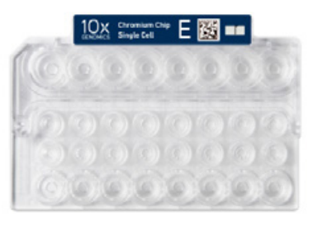
Library production: single-cell
10x Chromium
Modified Drop-Seq system, using gel beads and in droplet RT
System is a microdroplet encapsulator
Largely restricted to 10x assays
Can run 1 - 8 lanes in parallel

Slide 26
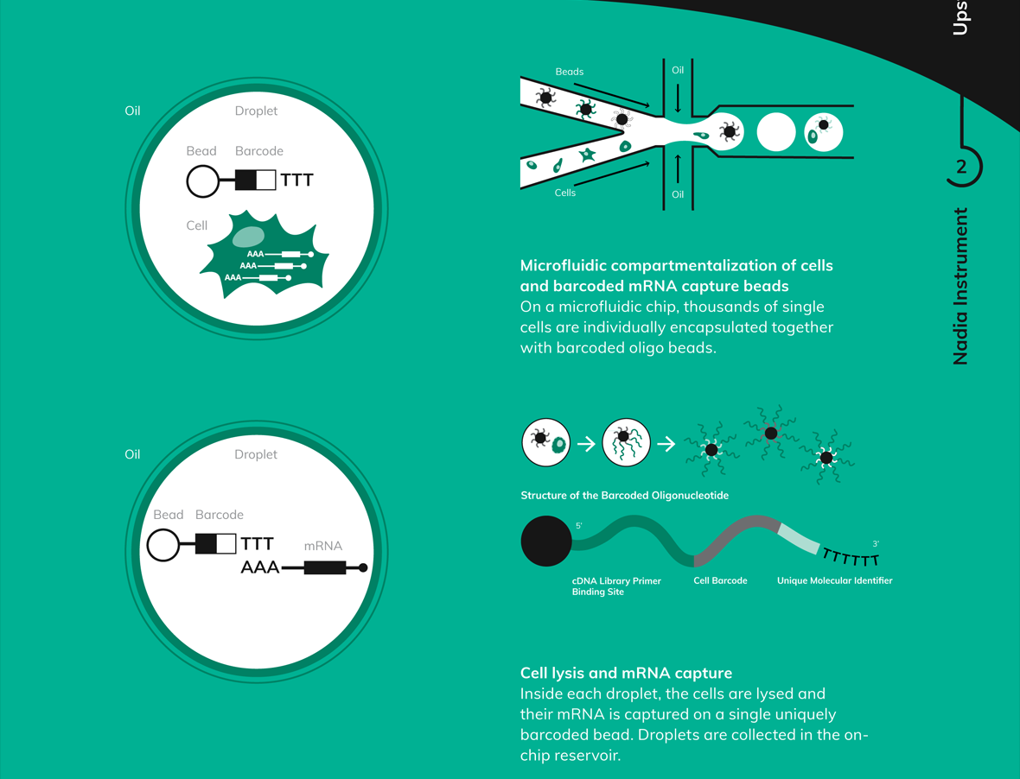
Library production: single-cell

Slide 27
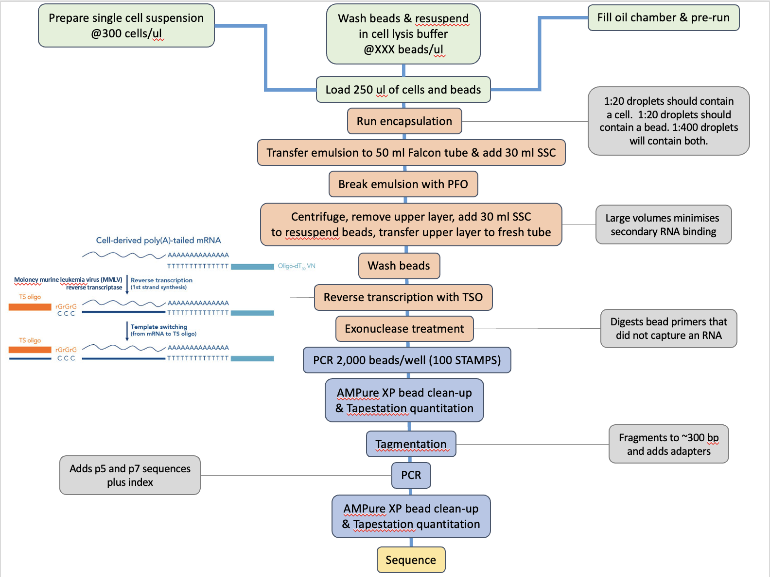
Library production: single-cell (Drop-seq)

Slide 28
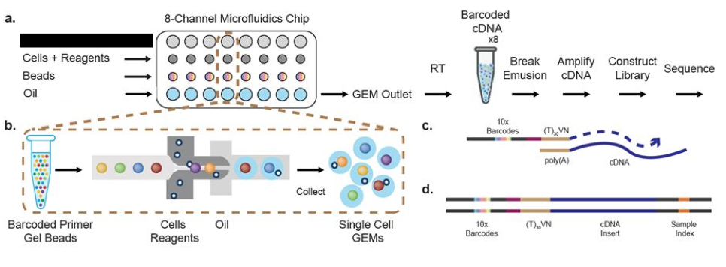
Library production: single-cell (10X)

Slide 29
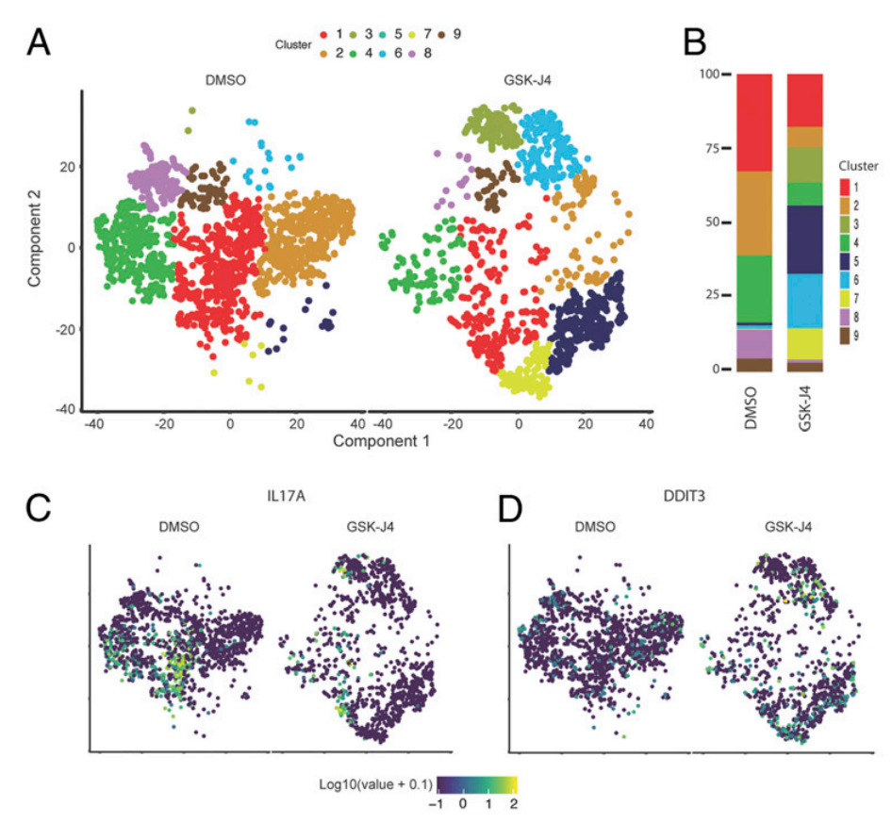
Single-cell sequencing applications
Histone H3K27me3 demethylases regulate human Th17 cell development and effector functions by impacting on metabolism
Proc Natl Acad Sci U S A. 2020 Mar 17;117(11):6056-6066.

Slide 30
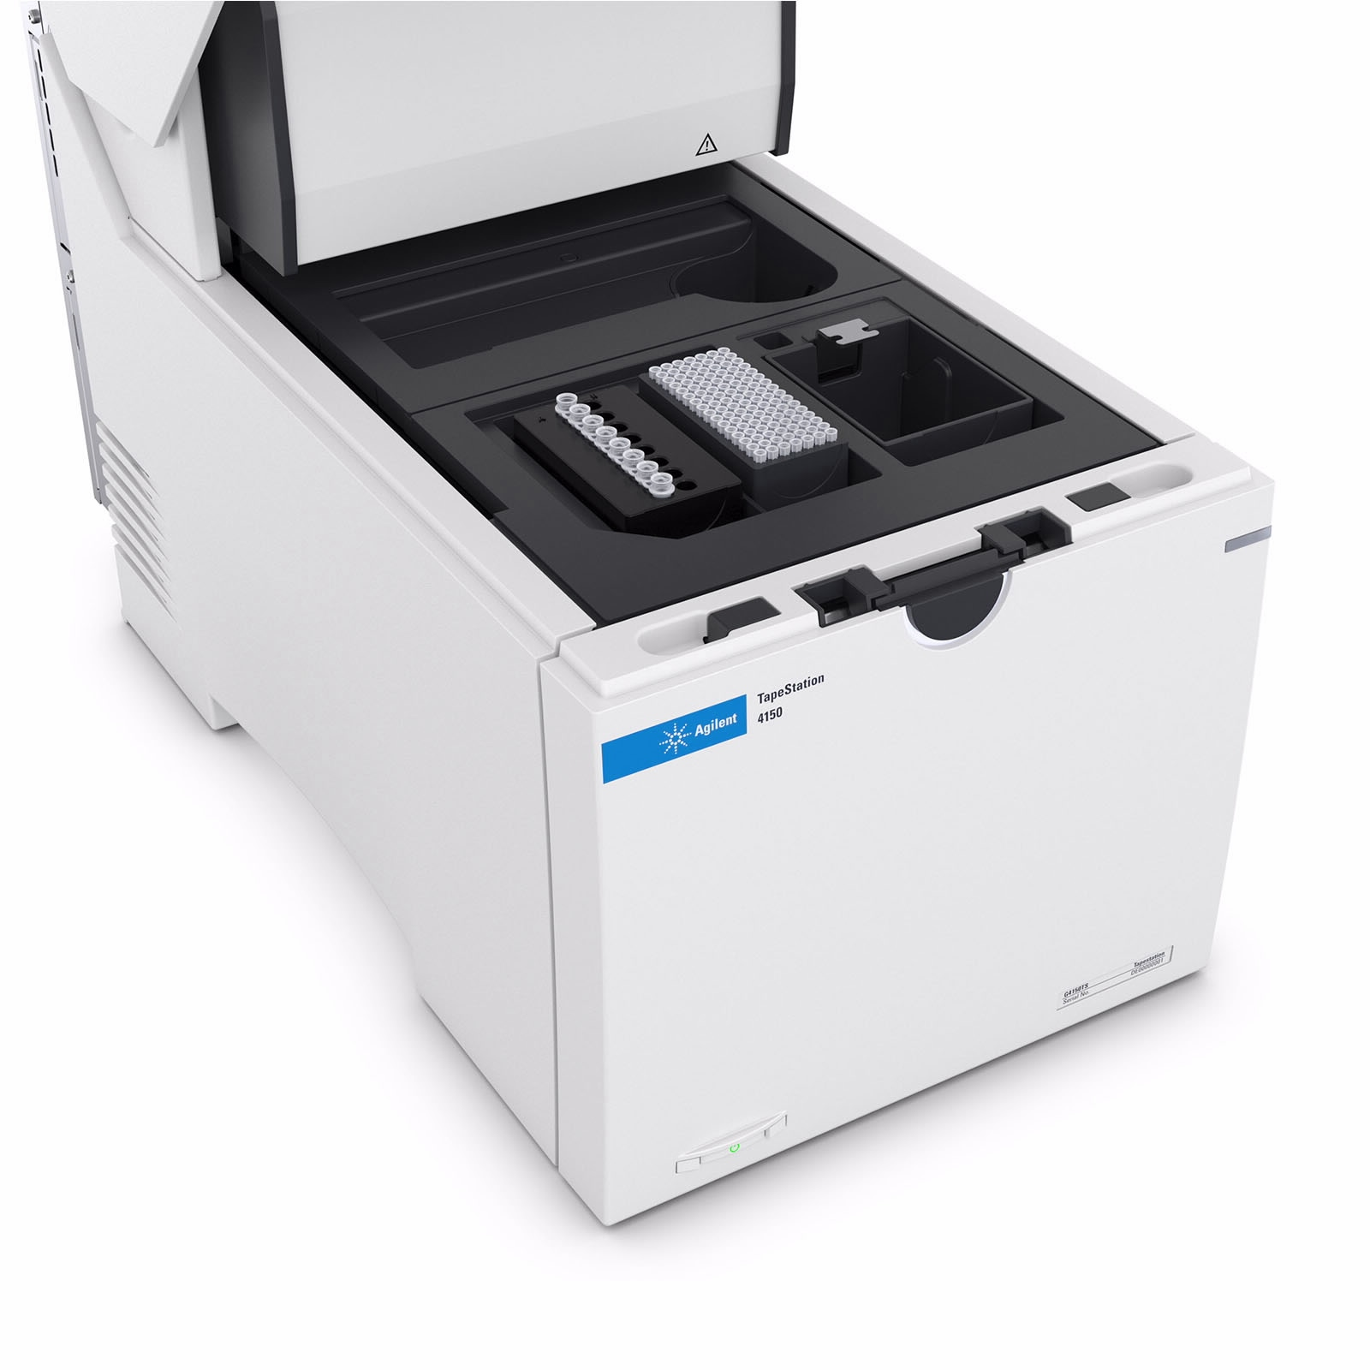
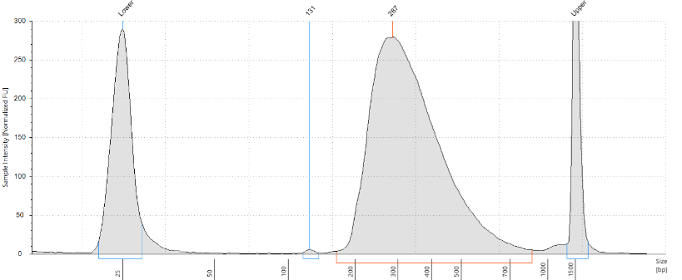
Library production: Quantification and pooling
Before any libraries can be sequenced, they need to be quantitated and (usually) pooled with other samples
Loading the right amount of pooled library is critical to optimal sequencing
Quantitation is performed on the Tapestation and samples are pooled such that they are all equimolar (assuming you want the same number of reads for each sample)

Slide 31
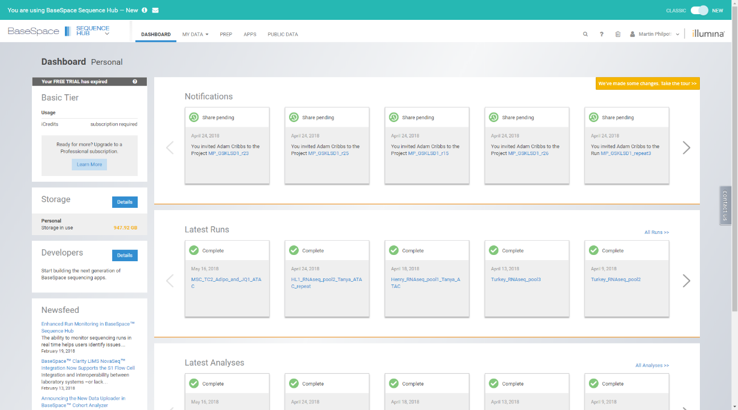
Setting up Illumina run
BaseSpace is the Illumina web-base software for setting up and retrieving sequencing runs

Slide 32
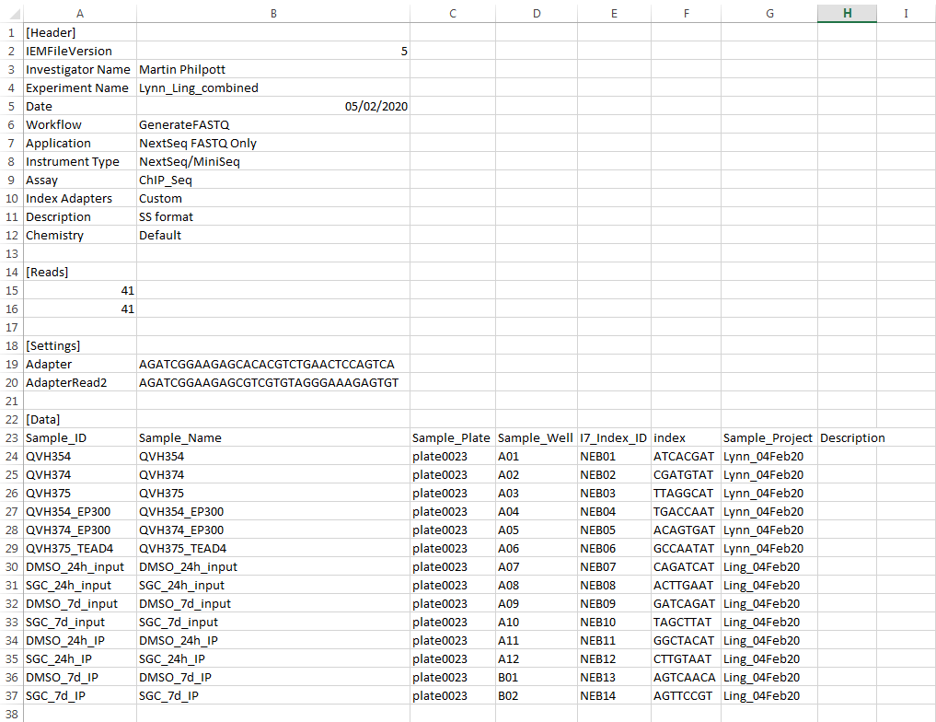
Setting up Illumina run

Slide 33
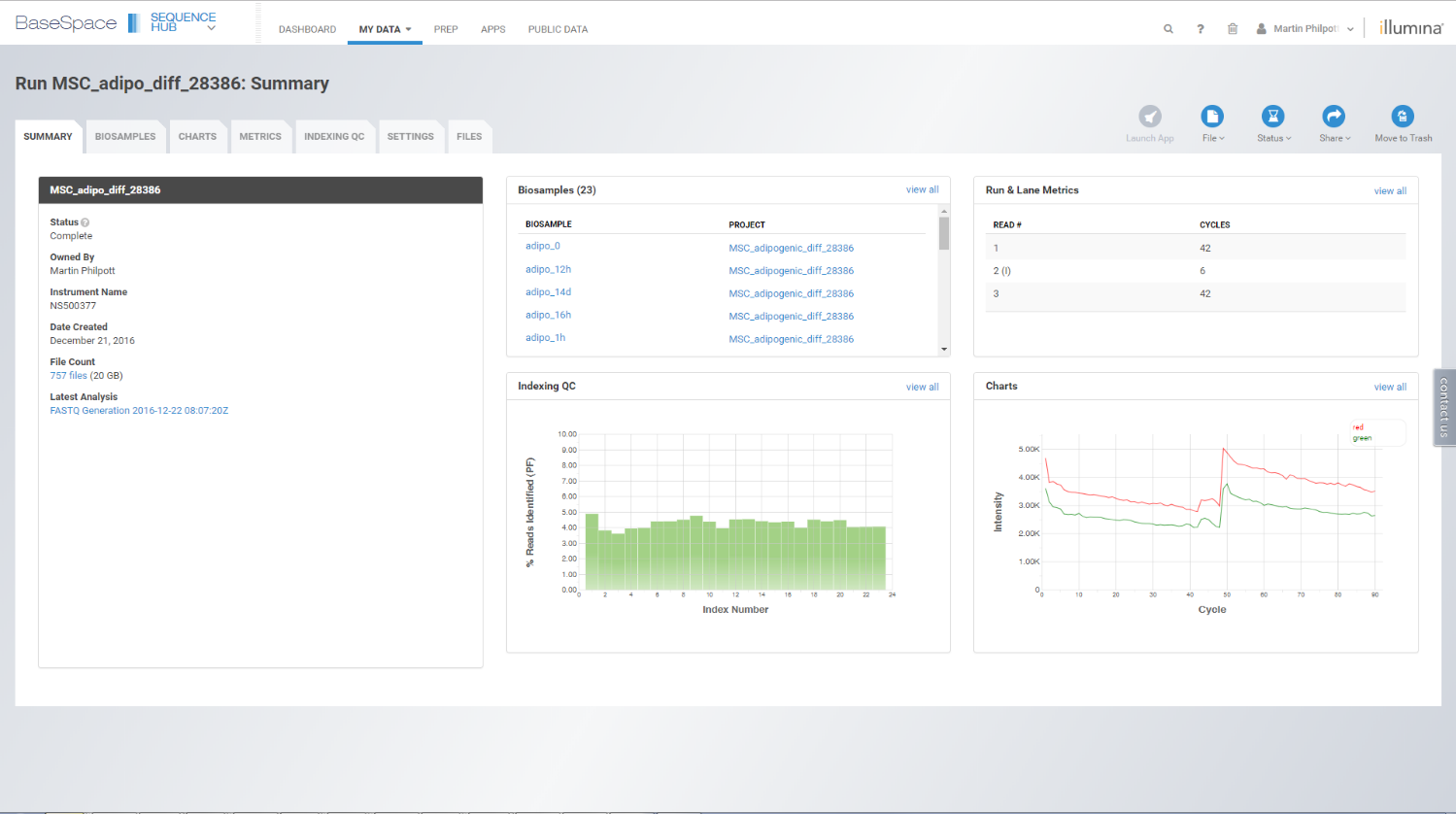
Output of an Illumina run

Slide 34
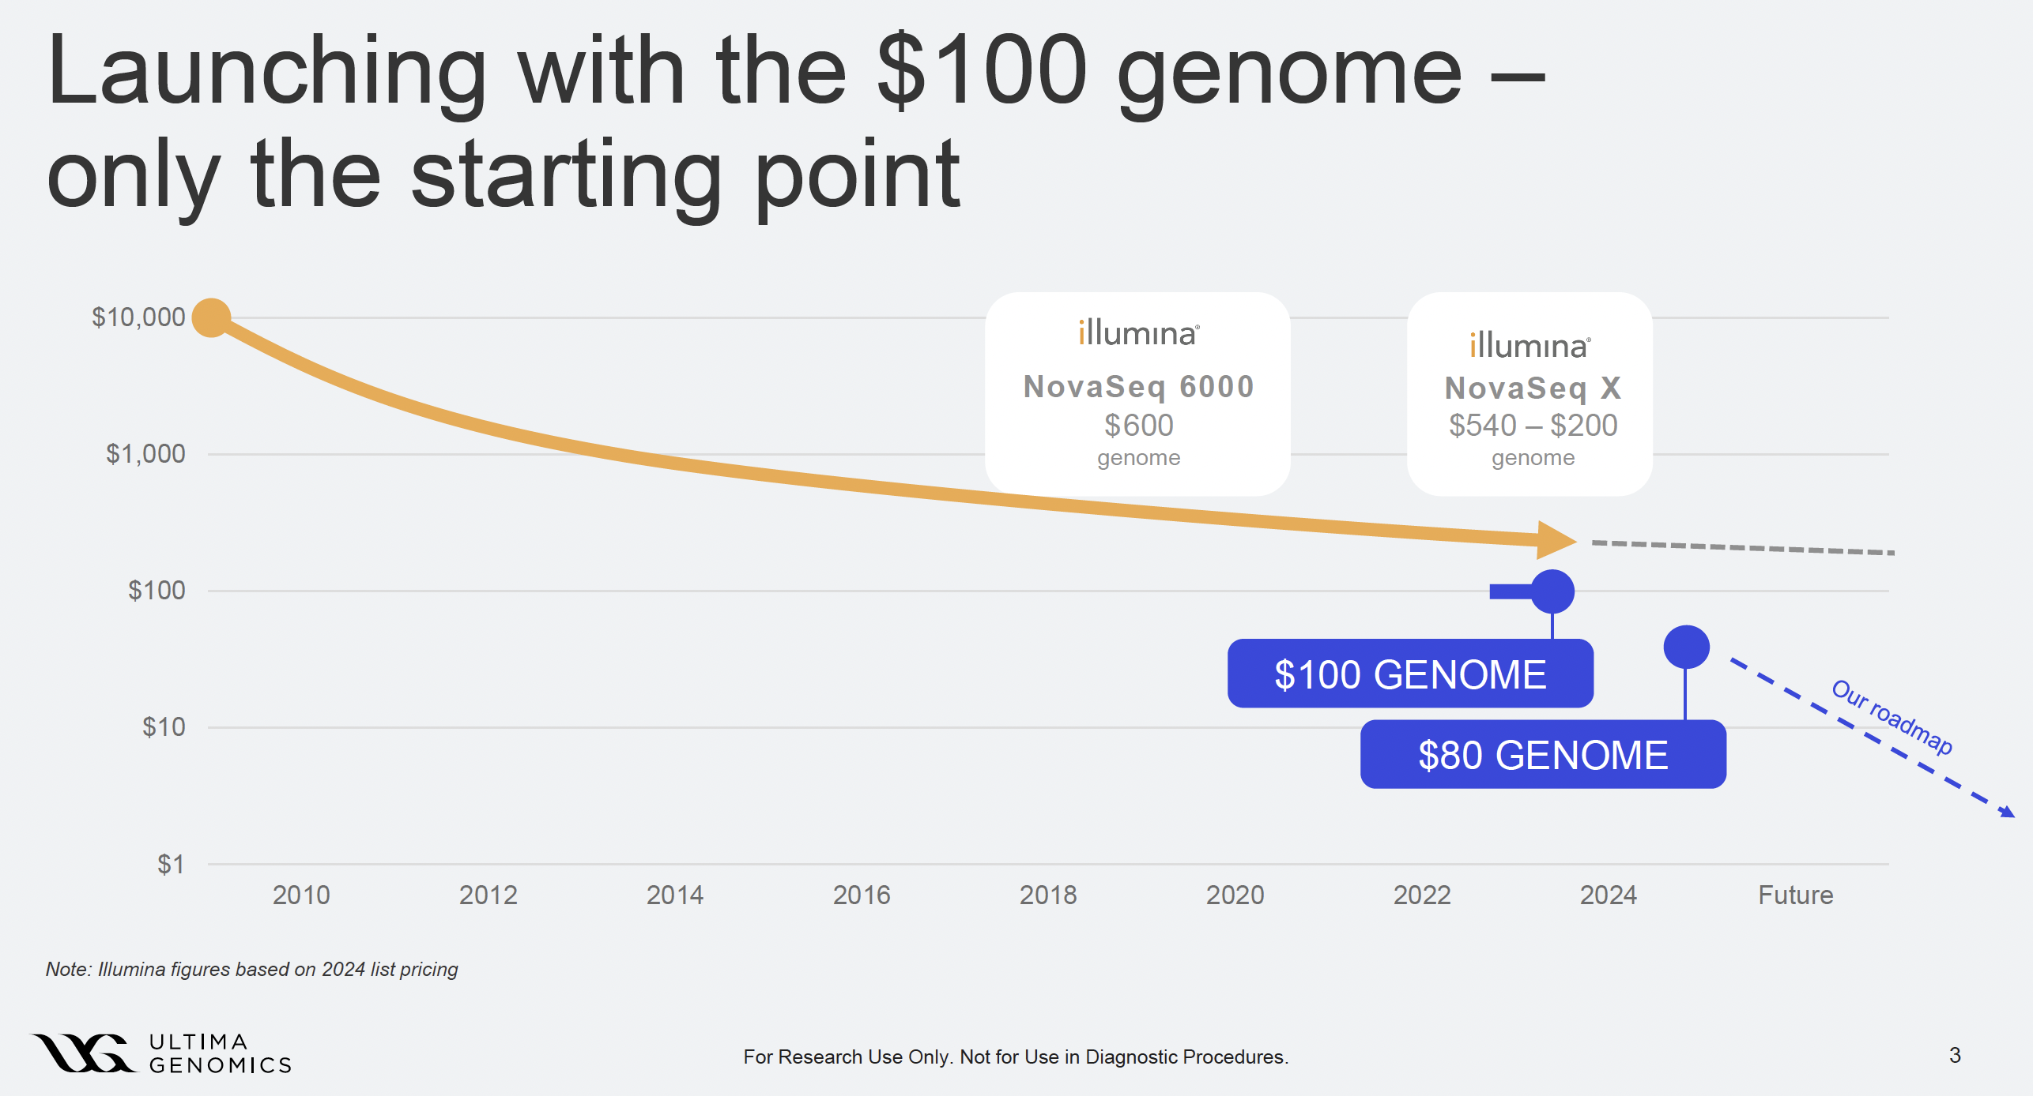
Ultima sequencing

Slide 35
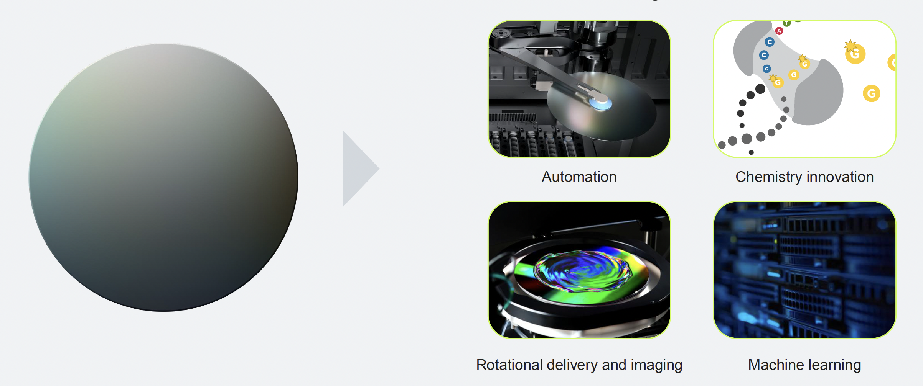
A new approach for sequencing short reads

Slide 36
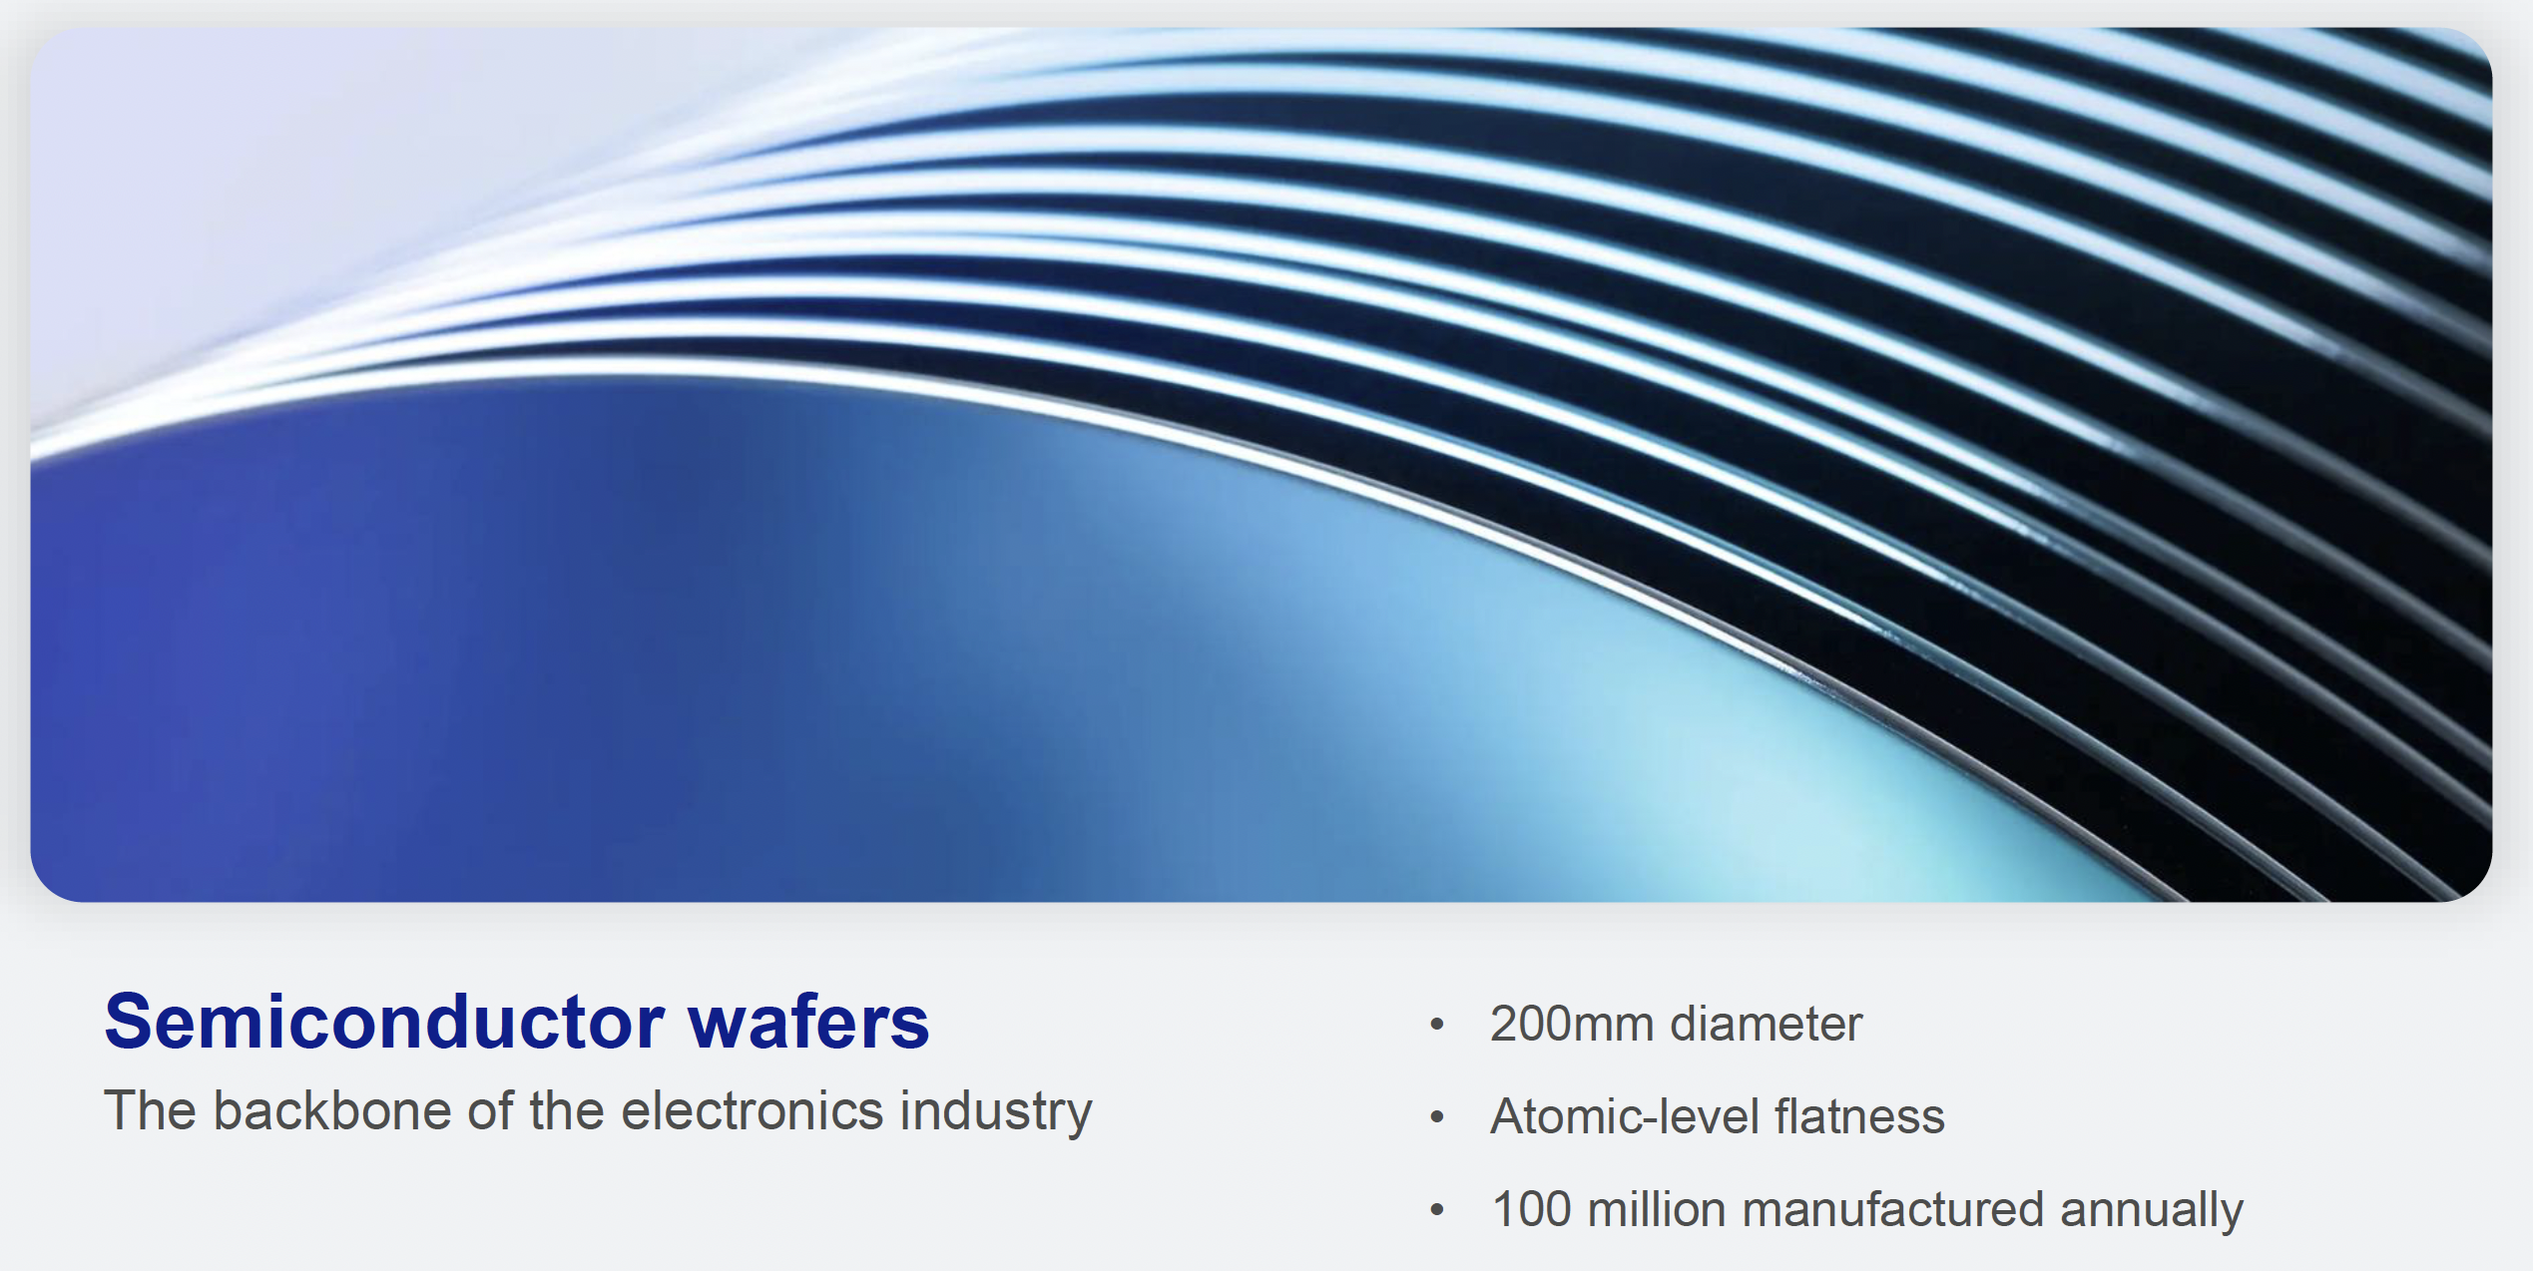
Wafer based technology

Slide 37
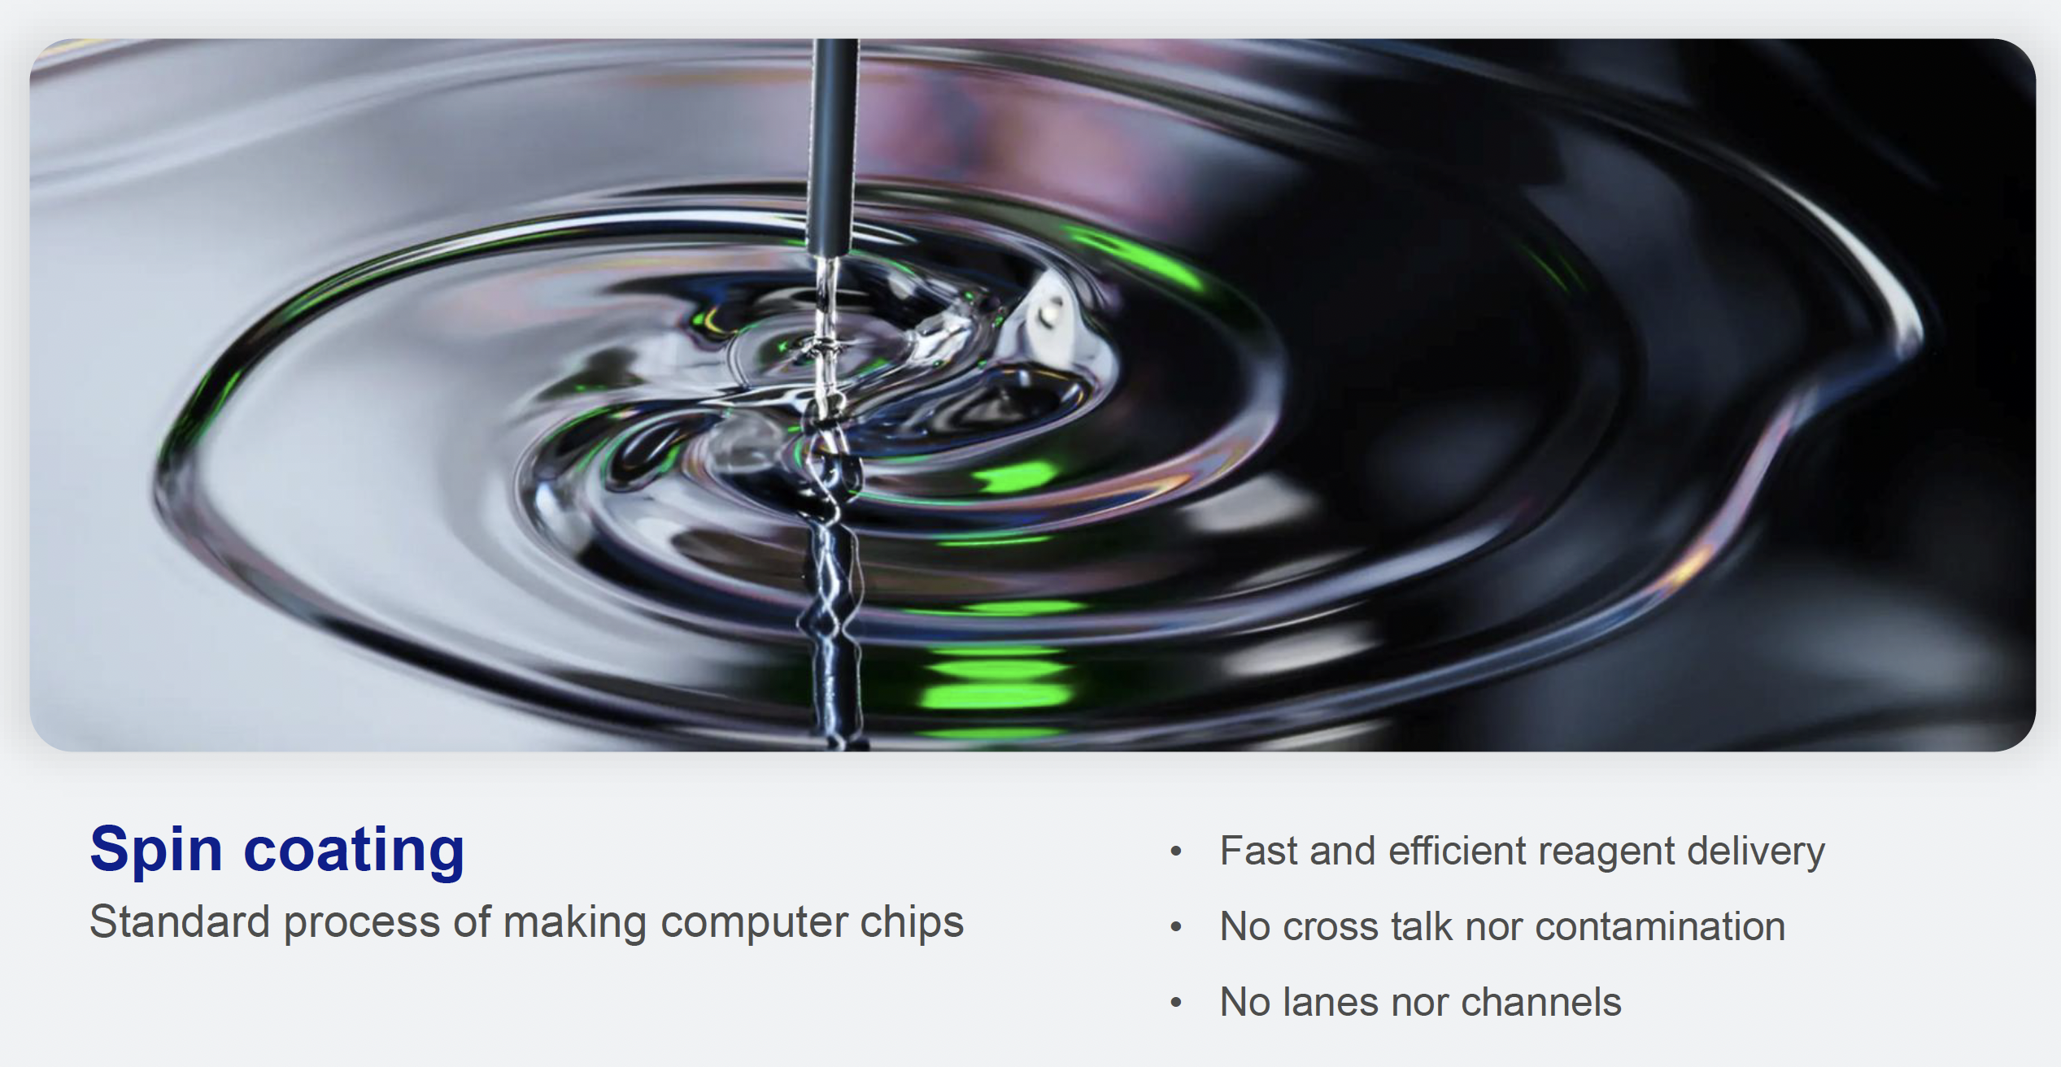
Beads are coated using spin technology

Slide 38
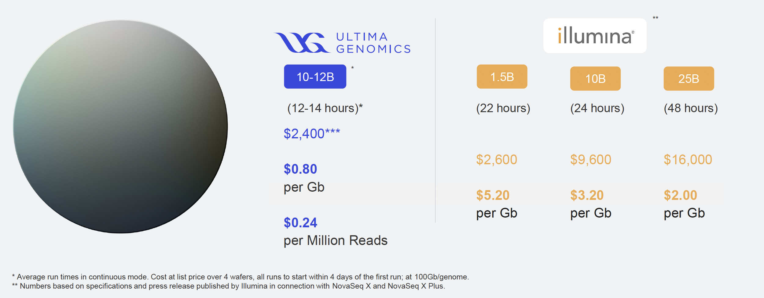
Significant cost reductions because of low cost consumables and chemistry improvements

Slide 39
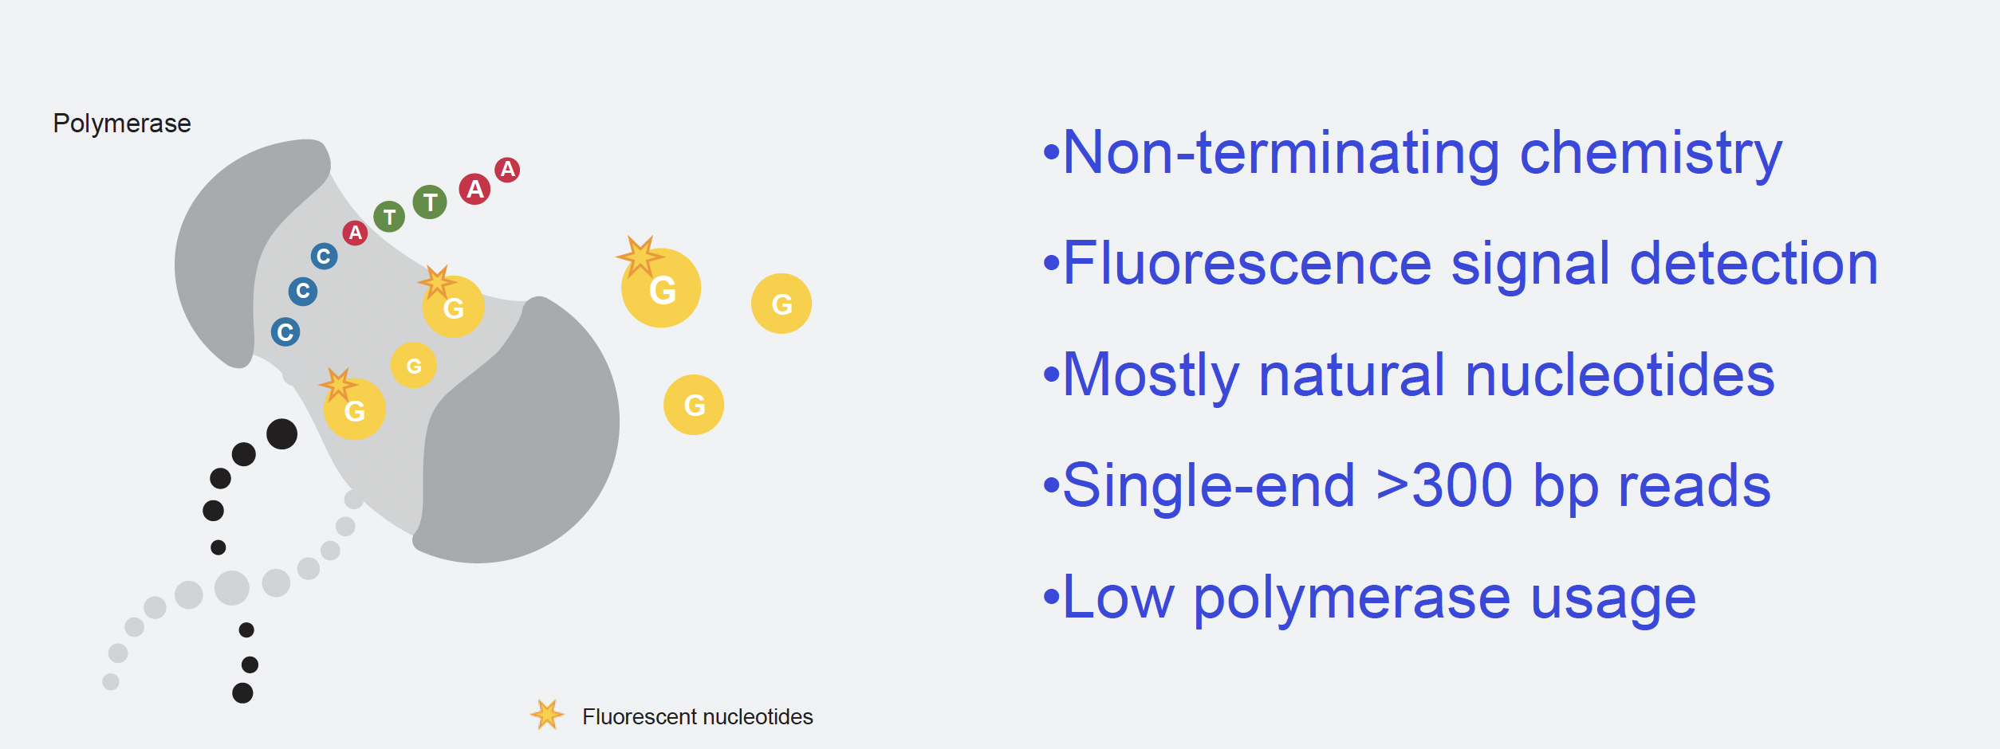
New fluorescence based measurments

Slide 40
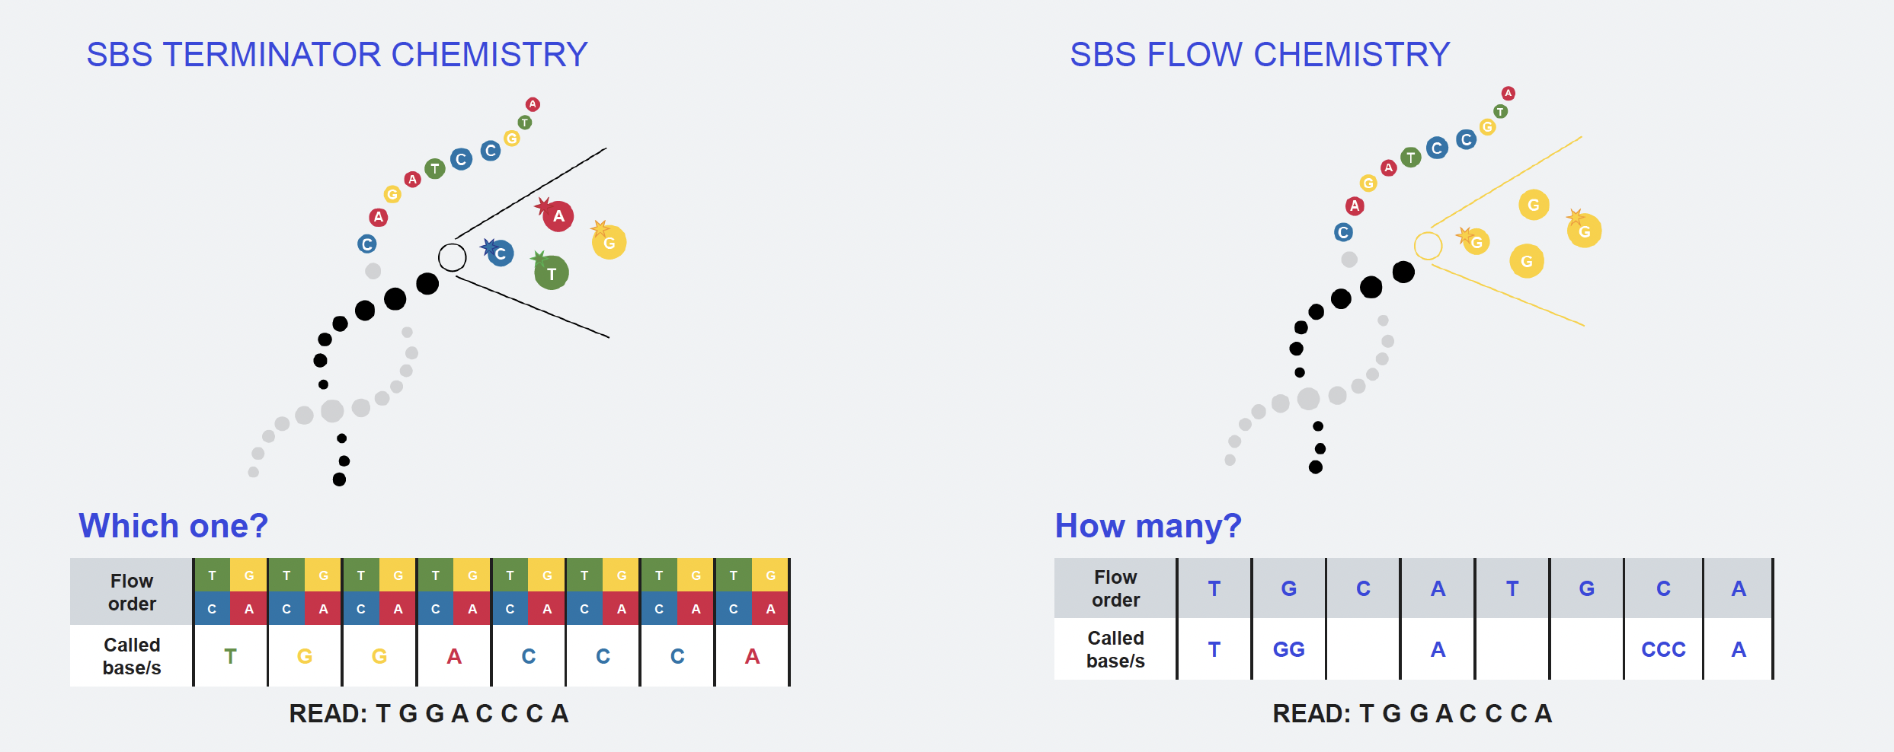
Significantly simplified chemistry
Ultima flows only one base at a time. For example, in the first cycle, only adenine (A) nucleotides are introduced. If the complementary base on a DNA fragment is thymine (T), the polymerase incorporates an A and emits a fluorescent signal. If not, no incorporation occurs and no signal is recorded. This single-base flow cycle is repeated sequentially (A, then C, then G, then T) across hundreds of cycles to reconstruct the DNA sequence one base at a time.

Slide 41
Oxford Nanopore Sequencing
3rd Generation sequencing
Long read sequencing (longest reported read >4 Mb)
High error rate (3-10%)
Genome sequencing
Complete and contiguous genome assemblies; de novo or reference guided
Resolve structural variants, breakpoints and repeat regions
Detect epigenetic modifications with direct sequencing and eliminate PCR bias
Targeted sequencing
PCR, hybrid-capture, CRISPR/Cas9 enrichment strategies
Large genomic regions and entire genes in single reads
Resolve structural variants, repetitive regions, SNVs and phasing
Gene expression
Full-length transcripts
unambiguous identification of splice variants and gene fusions
Eliminate PCR bias using direct cDNA or direct RNA sequencing
Identification of anti-sense transcripts and lncRNA isoforms
Full viral RNA sequence in one read
Long reads enhance viral identification from metagenomic samples

Slide 42
Oxford Nanopore Sequencing
https://www.youtube.com/watch?v=RcP85JHLmnI

Slide 43
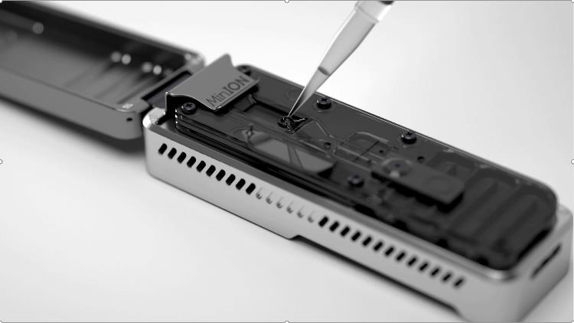
Oxford Nanopore Sequencing

Slide 44


Oxford Nanopore Sequencing

Slide 45



Oxford Nanopore Sequencing
Array of microscaffolds Each microscaffold supports a membrane and embedded nanopore.
Sensor chip Each microscaffold corresponds to its own electrode that is connected to a channel in the sensor array chip.

Slide 46


Oxford Nanopore Sequencing
Flush tether

Slide 47


Oxford Nanopore Sequencing
Motor protein
DNA polymerase (phi29 DNAP)
Helicase
Unzip dsDNA
ATP-dependent
Results in controlled ratcheting of ssDNA into the nanopore
Nanopore
Escherichia coli Curlin sigma S-dependent growth subunit G (CsgG)

Slide 48

Oxford Nanopore Sequencing
Ionic current flows through the pore
DNA passing through the channel disrupts the flow of ions
MiniION
GridION
PromethION

Slide 49



Oxford Nanopore Sequencing
Current measured ~5000/second
Changes in current are converted to “squiggles”
Basecalling achieved by machine learning algorithms that identify patterns in the squiggles

Slide 50

Oxford Nanopore Sequencing
When strand passes fully through pore, motor protein is released and pore can sequence another strand

Slide 51


PacBio sequencing

Slide 52
PacBio sequencing
https://www.youtube.com/watch?v=_lD8JyAbwEo&t=3s

